Slide 1
Structured Argument Unchained
Trevor Bench-Capon and Katie Atkinson
Department of Computer Science
University of Liverpool

Slide 2
Natural Deduction
Modus Ponens
And Introduction
Or Introduction
Conditional Proof
Double Negation
Modus Tolens
And Elimination
Or Elimination
Reductio Ab Absurdum
Several forms of Equivalent Expressions
Helps human understanding
Judgement Required to Select which rule to use
These help people, but hinder machines.

Slide 3
Machine Deduction
J.Alan Robinson
A Machine-Oriented Logic Based on the Resolution Principle". J. ACM. 1965
One single form of expression (CNF)
One inference Rule (resolution)
Understandability is not an issue
Removing judgement facilitates automation
Horn Clauses
Tractable
But no negated conclusions (hence use of negation as failure)
No disjunctions as conclusions
Cannot reason from P or Q:
Essential a chain of modus ponens applications (as in early how explanation)

Slide 4
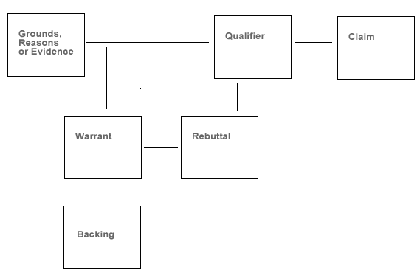
Argument in AI
Chain of inferences (resolution steps)
Toulmin’s Schema (1958)
MYCIN How Explanation (1984)
I know that P; Q because P, R because Q, therefore R.
Interpreted as Arguments (eg Bench-Capon and Sergot 1989)
Became the paradigm of argument:
Besnard and Hunter (AIJ 2001) - standard logic
ASPIC+ (Prakken A&C 2010) – defeasible logic
Founded on a knowledge base: arguments are (resolution style) deductions from this knowledge base

Slide 5
What’s Missing?
Reductio Arguments
Reasoning from Cases
Both Require Arguments as Premises
Conditional Proof to Infer Rules
Has an Argument as Conclusion
ASPIC+ only allows propositions as premises and conclusions
Sub arguments justify premises, but are not premises themselves

Slide 6
Comparison with Grounded Semantics
D is sceptically acceptable under preferred semantics, but not accepted under grounded semantics
A
C
D
Akin to reasoning
From cases
B

Slide 7
Example
Not S if P: S if Q: R if Not P: R if Not Q
Arguments
AI: P so Not S, A2: Q so S, A3: Not P so R, A4: Not Q so R
Assume P and Q:
Not (P AND Q): Reductio From A1 and A2 (Can deduce S and not S)
Not P or Not Q: de Morgan
R : Or-Elimination From A3 and A4
In ASPIC+ A1 and A2 rebut, so one is rejected. No option to conclude that the assumptions are not co-tenable
In ASPIC+ R would be conditional on the assumption of either Not P or Not Q

Slide 8
Conclusions
ASPIC+ captures the arguments that can be generated from a logic programming style knowledge base
But there are other stuctures of argument
Need to extend the definition of argument to allow arguments as well as propositions as premises.
Likely to be technically tricky!
Could also allow arguments as conclusions to accommodate conditional proof

