Slide 1
Norms and Extended Argumentation Frameworks
Trevor Bench-Capon, Sanjay Modgil
Department of Computer Science, The University of Liverpool, UK
Department of Computer Science, Kings College London, UK

Slide 2
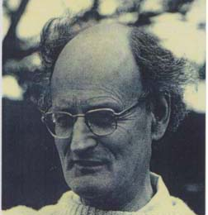
Overview
Norms are intended to influence (not determine) behaviour
They must play a role in practical reasoning – reasoning about what to do.
We follow Hare:
in a novel situation, we need to reason from first principles, but having arrived at a conclusion we “crystallise it into a not too specific or detailed form, so that its salient features may stand out and serve us again in a like situation without so much thought.”
In a novel situation we do practical reasoning without norms: but this reasoning can be encapsulated in a norm for future use
Norms emerge from practical reasoning and then are used in practical reasoning

Slide 3
Practical Reasoning
We use Atkinson and Bench-Capon’s value based practical reasoning
Situation represented as an Alternating Action Based Transition System
Arguments are Generated using the Argumentation Scheme for Value Based Practical Reasoning
Counter Arguments are generated using critical questions associated with that scheme
Arguments are organised into a Value Based Argumentation Framework
Arguments are evaluated according to the value preferences of the audience
The long version of the paper shows how this works for the parable of the Ant and the Grasshopper
https://intranet.csc.liv.ac.uk/research/techreports/tr2019/ulcs-19-001.pdf

Slide 4
Ant and the Grasshopper
In Summer, when food is plentiful
The ant works hard and gathers food for the winter
The grasshopper sits idly singing
In Winter there is no food
The grasshopper asks the ant for food
The ant refuses
The grasshopper dies
Moral: if you want to succeed tomorrow, you have to start working today. Those who do not plan for the long term will not succeed in the long term.

Slide 5
Norms from Ant and Grasshopper
Given that survival is the most important value people will choose to act like the ant.
This gives rise to the norm
You should work in summer
In future the norm can be used instead of going through the whole process
An additional norm is required to punish transgressors: otherwise the temptation to freeload will lead to normative collapse
You must not give food to a non-worker

Slide 6
Practical Reasoning in a VAF
Arg1: Work to live Arg2: Play for pleasure
If we prefer life we will choose to work
If we prefer pleasure we will choose to play

Slide 7
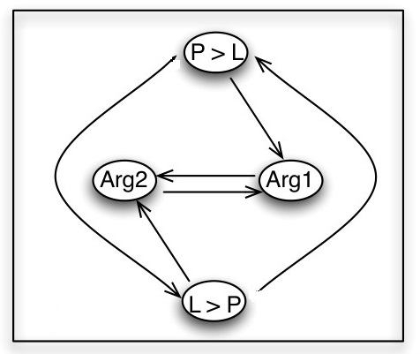
VAF with Explicit value arguments
Choosing a preference argument defeats one of the arguments (and the other preference)
Two possible extensions:
Prefer life and work
Prefer pleasure and play

Slide 8
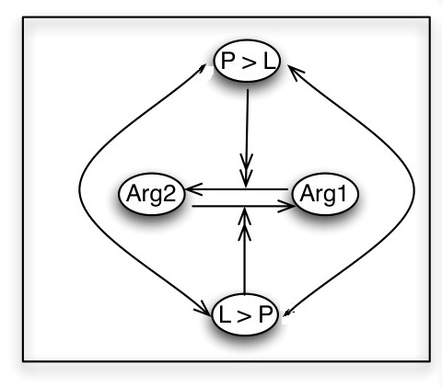
Extended Argumentation Framework
Now the preferences attack the attacks, not the arguments
Mazlow
Now the preference defeats the attack.
The preferred argument defeats the less preferred argument
We can justify the preferences with other arguments
Mazlow’s hierarchy gives a reason to prefer life

Slide 9
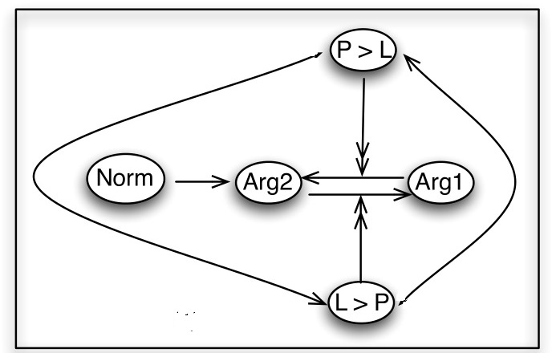
Representing a Norm
Now the norm can replace the
Reasoning
We cannot play because it is forbidden
Punishment
Preferences need not be considered if the norm is obeyed
A preference for pleasure might defeat the norm, so there is a temptation to violate
Norms need to be backed by sanctions

Slide 10
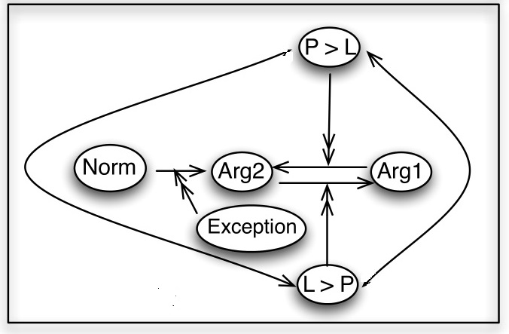
Representing An Exception
An exception attacks the attack from the norm
We are now free the choose between the actions according to our preferences. Both actions are permitted by the exception
In a standard VAF the exception defeats the norm
In an EAF the norm remains valid, although inapplicable

Slide 11
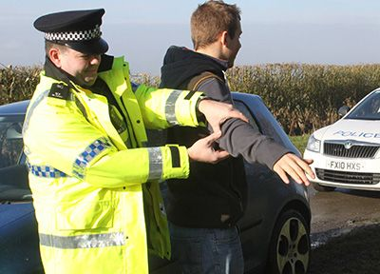
Fourth Amendment
Protects the citizen against unreasonable search of person or papers
A search is reasonable if there is probable cause and a warrant is obtained
Sometimes urgency is such that a warrant cannot be obtained
Evidence may be destroyed
Evidence may be moved to another jurisdiction
One such exception is for an automobile
Carroll v US – a 1925 case which involved a car transporting alchohol over the Canadian border.

Slide 12
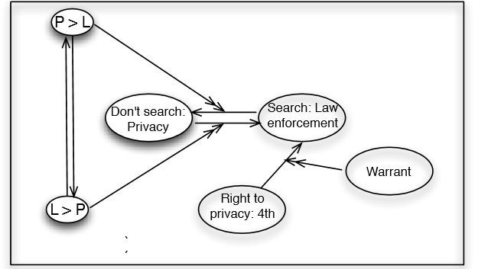
Fourth Amendment
Before the Fourth Amendment
Either action was permitted
Citizens and Police might have different preferences
Fourth Amendment
Prefers privacy and forbids search
But there is an exception if a warrant is obtained

Slide 13
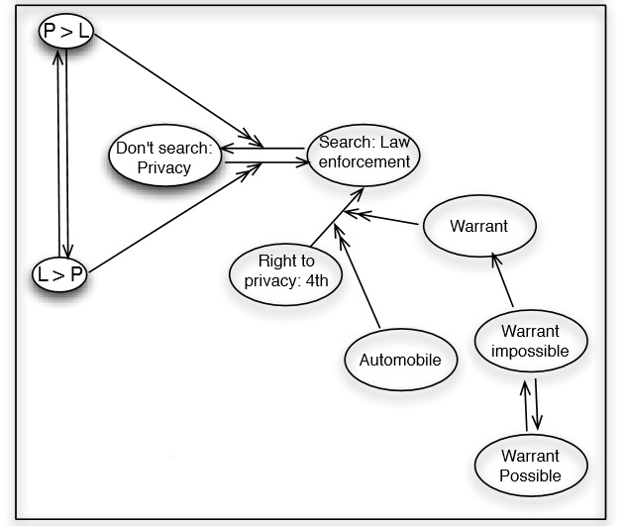
Automobile Exception
Sometimes it may be impossible to obtain a warrant
But law enforcement requires a search – so there need to be exceptions
It was established in Carrol that an automobile in transit may be such an exception

Slide 14
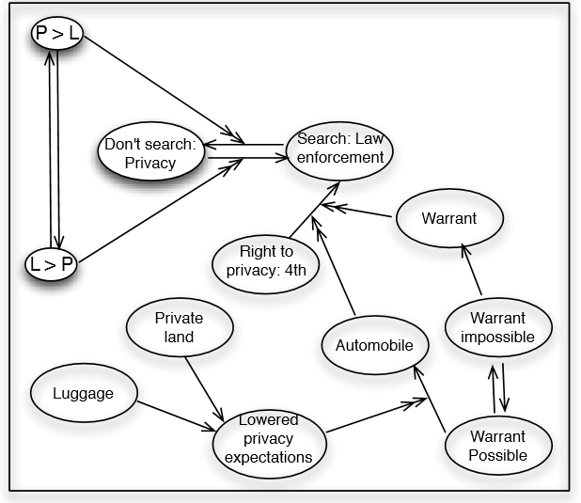
Situation after Opperman, Coolidge and Chadwick
It was argued that the automobile exception should not apply if a warrant could be obtained
Exception if there are lowered expectations of privacy
No lowered expectations of privacy if automobile on private land (Coolidge)
No lowered expectations of privacy for luggage in automobile (Chadwick)

Slide 15
Discussion: why EAFS?
Norms are traditionally represented using deontic logic
But there are alternatives:
State transition diagrams – popular in multi-agent systems
Argumentation frameworks - as used in this paper
Explicit, easy to understand, covers both emergence and use
Norms can be justified using practical reasoning with value preferences
But this reasoning can be encapsulated as an argument: the norm provides a reason for or against an action
We need to represent exceptions
In standard frameworks they appear as superior norms, defeating the general norm
In extended argumentation frameworks they prevent the norm from having an effect
The norm is not defeated

