Slide 1
Structuring E-Participation in Policy Making Through Argumentation
Trevor Bench-Capon
Department of Computer Science
Liverpool
UK

Slide 2

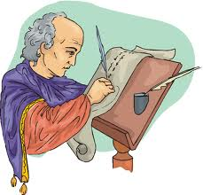
Participative Democracy
One feature of a democracy is that citizens can contact their representatives to:
  Seek justifications of policies;
  To object to particular policies;
  To advocate policy ideas of their own
Traditionally this was done by writing letters

Slide 3

E-Participation
But now we have the internet. This makes such communication
  Easier and quicker – quantity has increased
  But it does not improve the quality
    Neither for questions not answers
How can we improve quality?
  Using models of argument to provide structure
  Using domain models to generate and critique content

Slide 4
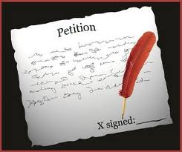
Currently UK - 1
E-Petitions
  Someone puts up a motion
  People sign it
  Sometimes (maybe) Parliament debates it.
But these petitions
  Often confuse several ideas
  Often put forward a number of unrelated arguments
  Signing is all or nothing: no specific points of agreement of disagreement
  No debate, no refinement

Slide 5

Currently - UK 2
Public Reading Website (UK)
Presents draft legislation section by section for comments. Comments just form a thread
But this site:
  Presents no supporting justification for the legislation
  Does not structure replies
  Does not relate replies
So what can be done with these responses?

Slide 6
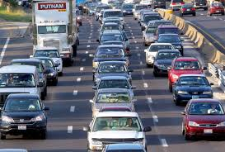
Example Petition:
Road Pricing
The idea of tracking every vehicle at all times is sinister and wrong. Road pricing is already here with the high level of taxation on fuel. The more you travel - the more tax you pay.
It will be an unfair tax on those who live apart from families and poorer people who will not be able to afford the high monthly costs.
Please Mr Blair - forget about road pricing and concentrate on improving our roads to reduce congestion.

Slide 7
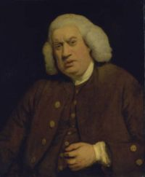
Why Are People Signing?
Dr Samuel Johnson (1709-84):
  The petition is then handed from town to town, and from house to house; and, wherever it comes, the inhabitants flock together, that they may see that which must be sent to the king. Names are easily collected. One man signs, because he hates the papists; another, because he has vowed destruction to the turnpikes; one, because it will vex the parson; another, because he owes his landlord nothing; one, because he is rich; another, because he is poor; one, to show that he is not afraid; and another, to show that he can write.

Slide 8
Confuses a number of issues:
More Roads Will Ease Congestion
The idea of tracking every vehicle at all times is sinister and wrong. Road pricing is already here with the high level of taxation on fuel. The more you travel - the more tax you pay.
It will be an unfair tax on those who live apart from families and poorer people who will not be able to afford the high monthly costs.
Please Mr Blair - forget about road pricing and concentrate on improving our roads to reduce congestion.
Civil Liberties
Fuel Tax Does the Same
Unfair
All of These? Any of These?

Slide 9

A Stock Reply
Will address all these issues
Much will be irrelevant
Tends to be bland
Is impersonal
Cannot address issues not raised in petition
Phrasing of petition often faulty
Not really structured engagement
– no real communication
Exchange of arguments
– not opinions -is what is needed
Explanation of policy to inform public opinion

Slide 10

Problems with Current Tools
Problem of analysis: too much data
  How can we systematically organise the analysis of comments?
  How can we organise the information to accurately identify issues and consult participants in further depth?
  Abundance of claims, counter-claims, evidence, points of view, etc. results in a rich “web” of information. How to manage and reason with so much data (aggregating)?

Slide 11
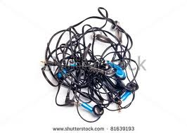

Problems with Current Tools
Problems with lack of structure
  Comments are in an unstructured and unsystematic format. Use of threaded lists, but difficult to extract meaningful information.
  Comments are not sufficiently fine-grained to be as informative as may be needed. Underlying motivations and justifications are not made explicit.
Problems with bias
  Experts who mediate, analyse, and summarise the comments can bias information or obscure the relation between comments and policy outcomes. Outlier, hybrid, challenging, and novel positions on issues may get “lost”. Not a public, transparent method.

Slide 12

Problems with Current Tools
Problems with the dialogue model
  Lack of support for reasoning processes (inference, modelling, consistency, alternative policy positions).
  Little interaction and feedback among stakeholders and between stakeholders and the consultative body. There is no deliberation.
  Hierarchical information flow .
    "wisdom of crowds" and crowd-sourcing.

Slide 13

Can we do better than this?
Current systems make good use of www technology, but they lack expertise and knowledge.
  Computational argumentation provides us with methods of argument representation and evaluation. This provides the expertise.
  When building tools to support citizen participation, need to strike a balance between the use of structured argument and ease of use of the tools.
  But the argumentation requires knowledge to instantiate the argumentation structures. So we need an underlying model as well.

Slide 14

Policy Discussion is
Difficult
It is really quite difficult to
  Construct a coherent argument
  To maintain relevance and focus
  To get the facts right
  To Understand an argument
  To Identify and Answer specific objections
  To answer at the correct level of detail
  To relate, combine and aggregate arguments
  For citizens and Government
Structured Argumentation can supply the expertise to help with all of these

Slide 15
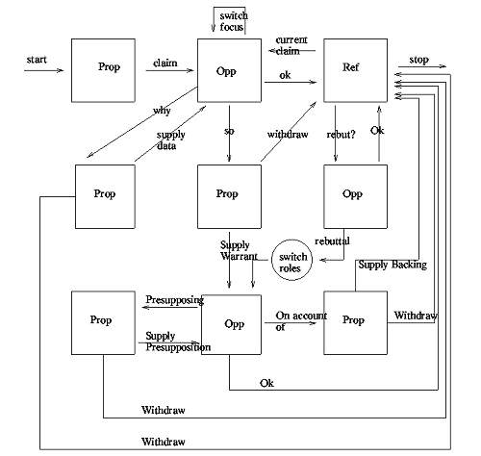
Argumentation Schemes
Argumentation schemes represent stereotypical patterns of reasoning
  As such the form is familiar to the reader
They provide presumptive reasons for their conclusions
  Arguments can be defeated by counter arguments
  Arguments often make assumptions
  Arguments often have exceptions
Argumentation schemes can be attacked in ways characteristic of the scheme
  Sometimes called critical questions
We have developed a formal model of argumentation schemes and their relations

Slide 16
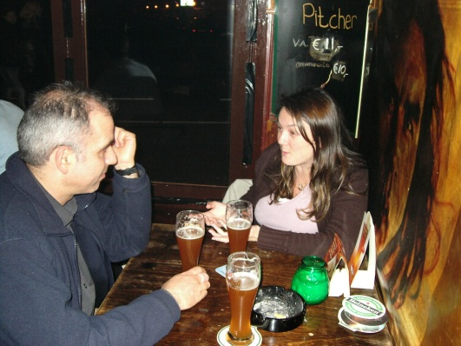
Scheme for Practical
Reasoning
Practical Reasoning – justification of an action
  In the current circumstances R
  We should do this particular action A
  So that the circumstances will become S
  Which will realise a goal G
  Which will promote a value V
S is the result of A, G is what we wanted to achieve by A, and V is the reason we wanted G

Slide 17

Several Types of
Knowledge Required
Factual Knowledge - what is currently true?
Causal Knowledge – what are the consequences of actions?
Ethical Knowledge – what values are worth promoting?
Evaluative Knowledge – what circumstances will promote/demote these values?
Behavioural Knowledge – what will other agents do?

Slide 18
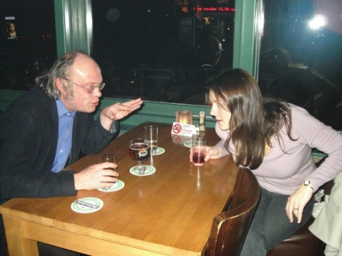
Ways of Criticising
The different types of knowledge mean that there are a number of distinct ways of attacking an argument based on the scheme
We have identified seventeen distinct ways of attacking instantiations of the scheme – some with several variants
  Some identify assumptions
    About what is the case
    About how people will react
  Some require choices
    What level of risk is acceptable?
    What values do we want to promote?

Slide 19
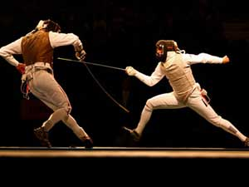
Example Attacks
The facts are /might be different
Other agents might behave differently
The consequences would be/might be different
The value is not worth promoting
Some more important value might be demoted
A different action would promote other values
The same value could be promoted differently
The action is not possible

Slide 20
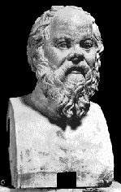
Second Layer of Justification
Argument from Credible Source – Justification of a fact on the basis of an authoritive person or text
  S is a credible source for information about a domain D
  I is an item of information in domain D
  S claims I
  So, I is presumed true
Normally this is enough: rarely do we
reason from first principles. E.g we cite a text
book, not experiments to justify causal
relations

Slide 21

Web Tool for Justification
Displays a series of screens, representing the attacks characteristic of the scheme justifying the current position
  Originally implemented at Parmenides
    Katie Atkinson
  Re-engineered as Parmenides
    Dan Cartwright http://cgi.csc.liv.ac.uk/~parmenides/
If the user agrees, move on to the next point; otherwise justify that point and solicit feedback on that argument
  The SCT developed as part of the IMPACT project
    http://impact.uid.com:8080/impact/

Slide 22
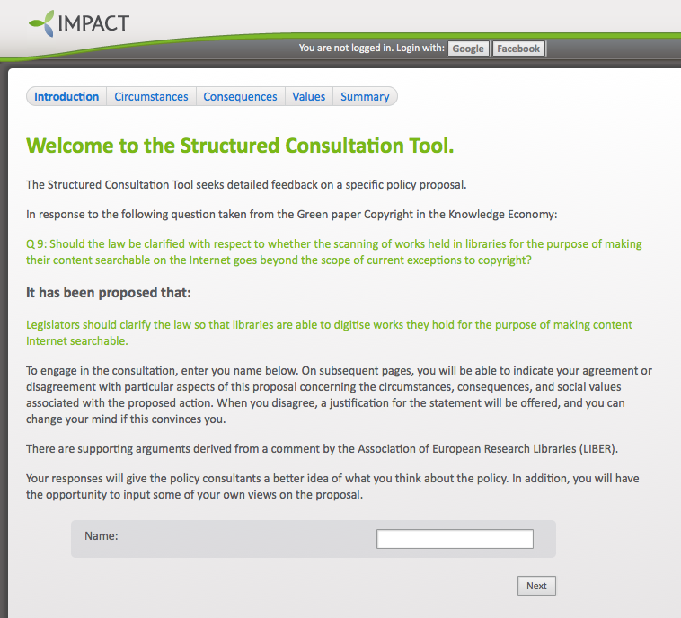
Intro page to the SCT

Slide 23
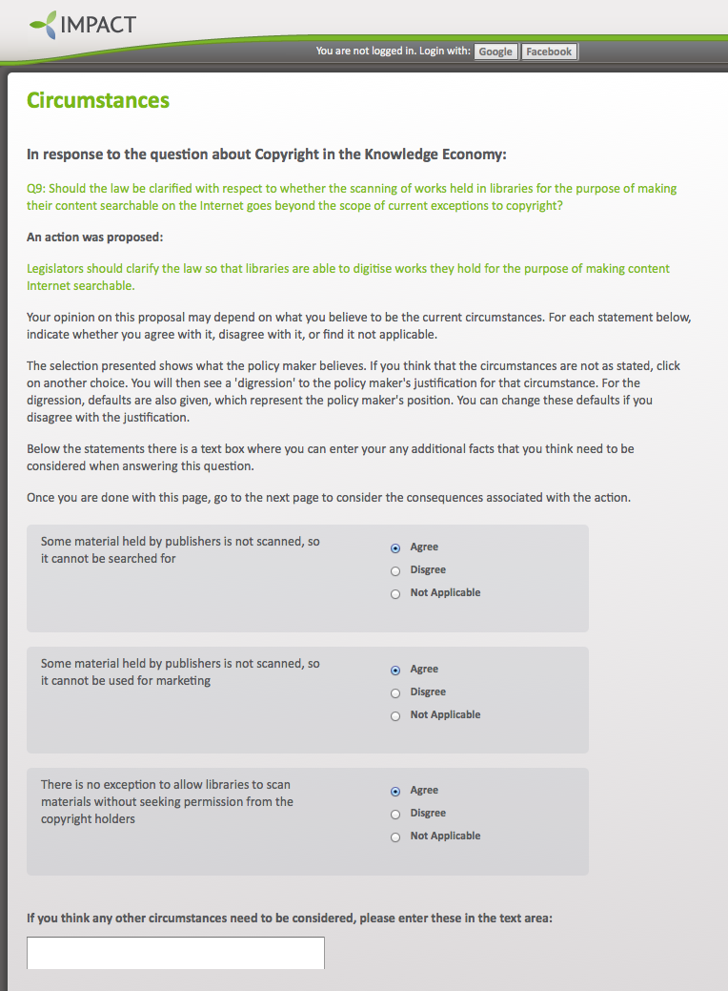
SCT circumstances page with defaults

Slide 24
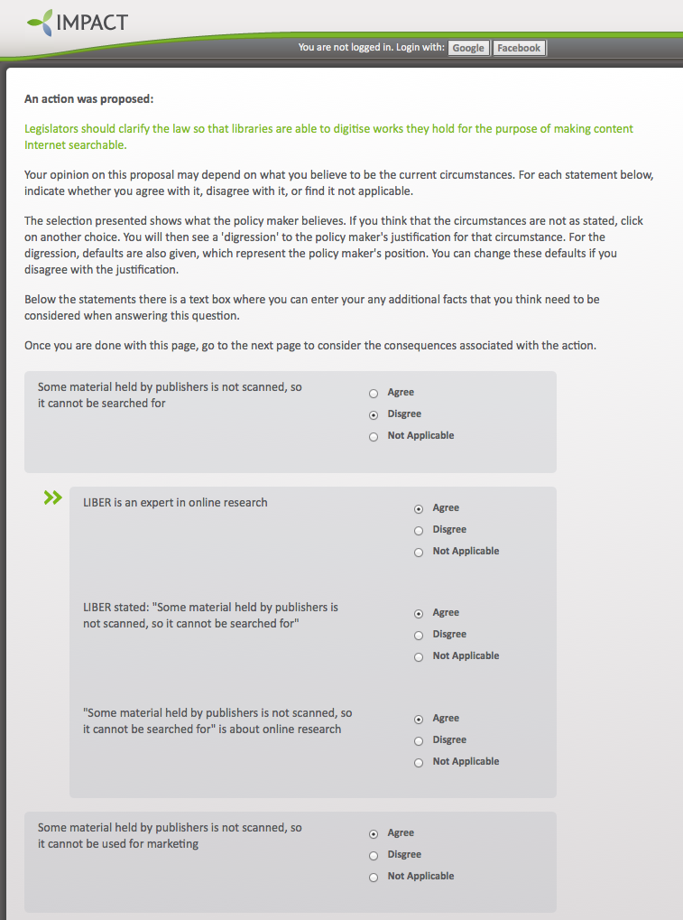
SCT circumstances page with digressions

Slide 25
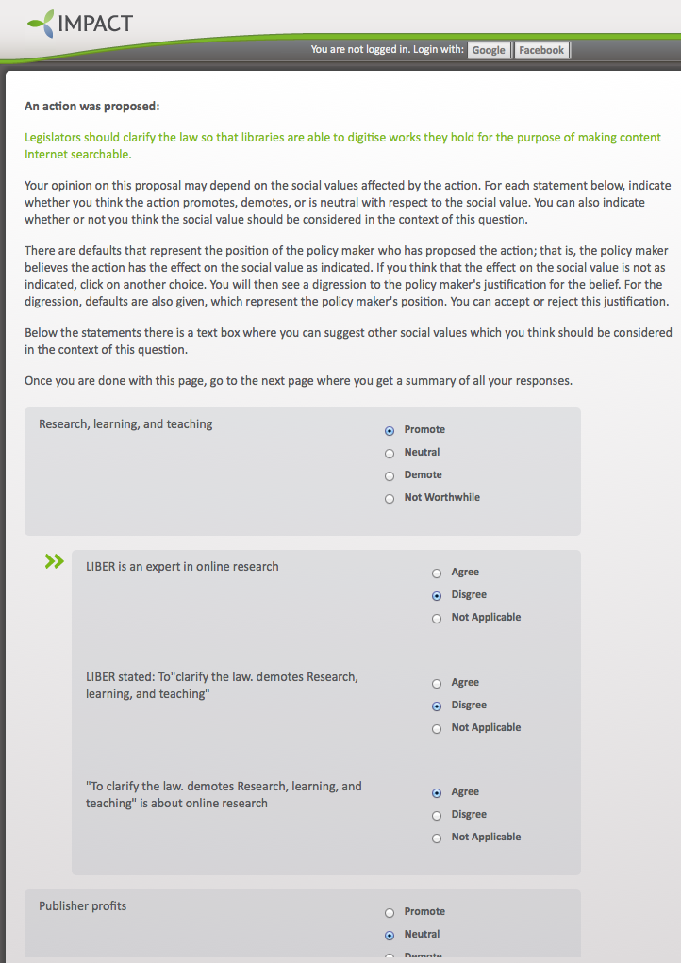
SCT values page with digressions

Slide 26
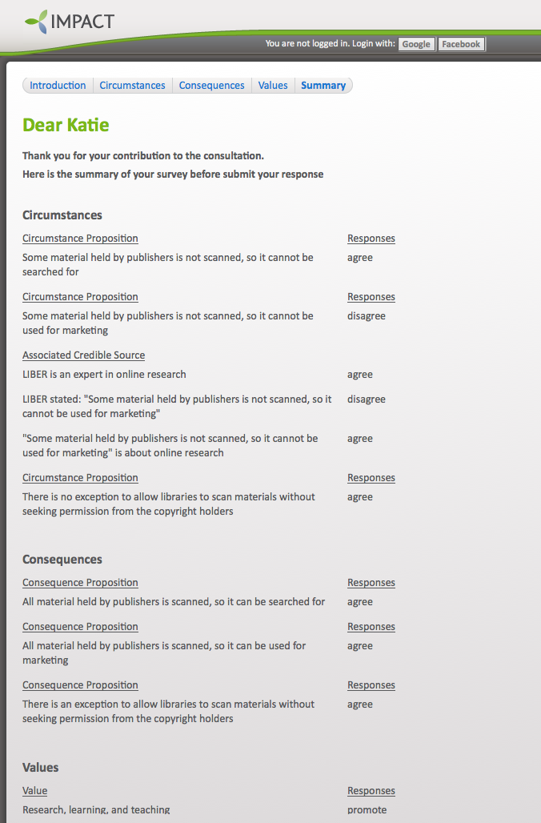
Excerpt from SCT summary page

Slide 27

Advantages
Justification is structured
  Officials as well as citizens need help to make good arguments
Interaction has a natural flow
Replies are cogent and to the point
  Specific points of disagreement are identified
No training or theory is required
  Users only have to answer “yes” or “no”
Common structure allows for replies to be related and aggregated
  Identifies which aspects of the policy require change or better explanation

Slide 28
Underlying model
Behavioural Knowledge
Underlying model is a Action-Based Alternating Transition System with Values
  States: What is true
  Agents: Those who can affect the situation
  Actions: What they can do
  Preconditions: States in which the action can be performed
  Transitions: Maps from states and joint actions to new states
  Propositions: What is relevant
  Values: What we wish to promote
  Evaluation Function: values promoted and demoted by transitions
Factual Knowledge
Causal Knowledge
Ethical Knowledge
Evaluative Knowledge

Slide 29

Example – Speed Camera Debate
We want to reduce number of deaths on roads
Encourage motorist to obey speed limits
Introduce speed cameras to improve detection
  Is there a problem?
  Will speed cameras work?
  Intrudes on privacy?
  Alternatives – educate motorists?

Slide 30
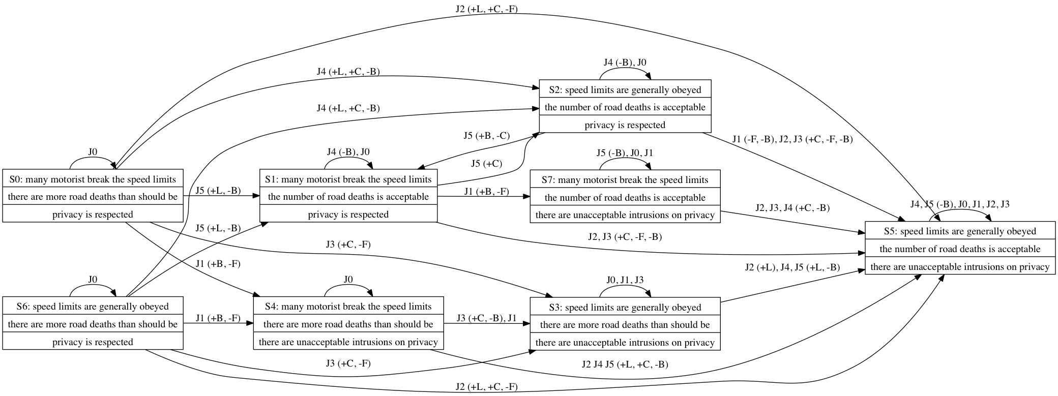

A state diagram

Slide 31
Joint Actions

Slide 32
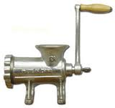
Generating Arguments
Identify the current state
If there is a transition which promotes the value, then we can instantiate the argumentation scheme.
Attacking the argument
  Challenge assumptions about e.g. the current state
  Consider
    alternative states that can be reached with the same individual action
    Values demoted by the transition
    Other transitions promoting the value
    Other models of the situation

Slide 33

Agreeing on the Current State
The user has to state, for each relevant proposition, whether it is true or false;
Can get arguments for or against the propositions
  Argument schemes,
  Web pages

Slide 34
Critique Tool – Current State

Slide 35
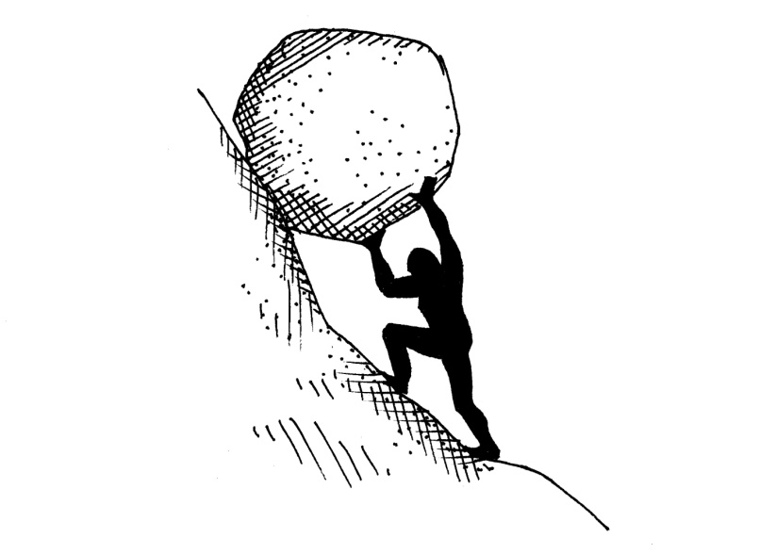
Is the Action Possible?
Once the current state is fixed, we determine whether the action is possible
  If the action is not possible, and explanation is given
    Usually a web page explaining what the action requires (argument from credible source)

Slide 36
Critique Tool – Action

Slide 37

Are the Consequences Agreed?
This considers whether the consequences as envisaged by the user
  Again can access additional material for extra information, or argument to resolve disagreement

Slide 38
Critique Tool – Consequences

Slide 39

Is the Value Promoted?
Next we consider whether the goal the user wishes to achieve will fulfil the desired purpose.
As usual supporting argument and explanation is available

Slide 40

Are There Negative Side Affects?
Action can have bad consequences as well as the ones that were intended
These may not have been foreseen
A choice is required as to whether the price is worth paying

Slide 41

Are there Other Ways to Promote the Value?
There may be other ways to achieve the desired results
These need to be considered
They must be rejected as a conscious choice, not because they have been overlooked

Slide 42

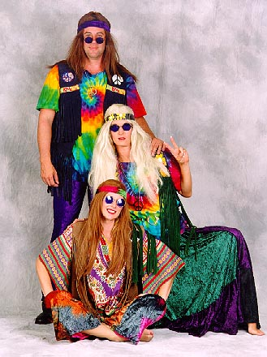
Could Other Values be Promoted?
Doing one thing means that other things cannot be done
Actions must be consciously prioritised.

Slide 43

Will the Other Agents Do What they are Supposed To Do?
Sometimes the effect of an action depends on what others will do
Will motorists change their behaviour if speed cameras are installed?
How plausible are the assumptions about what others will do?

Slide 44
Critique Tool – Auxiliary Effects

Slide 45

Formulating the Critique
All of these questions can be posed and answered using fairly simple queries on the AATS
For example:
  Are there other joint actions leading to a different state?
  Are there values demoted by the transition?

Slide 46

Implementation
Model is stored as a MySQL database
Queries are standard SQL
Interface using PHP
Available at
http://cgi.csc.liv.ac.uk/~maya/ACT/index.php

Slide 47

Advantages
The argumentation scheme, critical questions and the underlying model together allow us to automatically generate a systematic and intelligent critique of a proposal
  Challenges assumptions and factual errors
    Provides supporting arguments if required
  Offers alternative
    Ways of achieving the goal
    Values to pursue
  Identifies flaws
    Bad side effects
    Risks

Slide 48

Summary
Current tools for e-participation allow people to express their feelings, but do not support:
  The articulation of their views
  Stating specific points of agreement and disagreement
  Collating and relating contributions
  Aggregating opinions to assess public opinion
The tools describe use models of argumentation and the various types underlying knowledge to provide this support
Supply expertise to facilitate the tasks

Slide 49

Take Home Message:
E-participation has developed some popular and good looking tools which have excited interest
But these are predominately web technology which restricts their usefulness
We can make the more useful by using intelligent systems techniques
Argumentation schemes and an underlying model of the various types knowledge provides a promising example

Slide 50


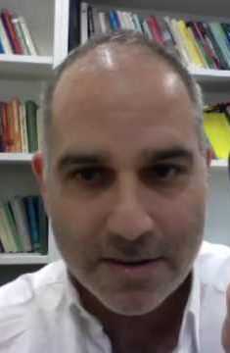
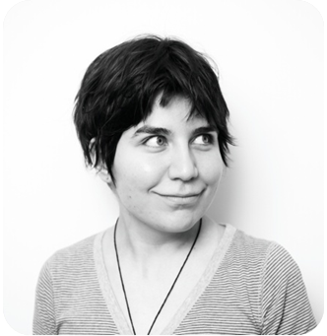
Thanks To:
This represents joint work over the last decade, first published at E-GOV (DEXA) in Prague 2003
  Parmenides I - Katie Atkinson
  Parmenides 2 – Katie Atkinson and Dan Cartwright
  IMPACT Project – Katie Atkinson and Adam Wyner
  SCT and Critique Tools - Katie Atkinson, Adam Wyner and Maya Wardeh
Thanks also to all the friends and colleagues I have discussed argumentation with

Slide 51
