Slide 1
The Long and Winding Road 40 Years of Argumentation
Trevor Bench-Capon
University of Liverpool
Comma 2012, Vienna

Slide 2
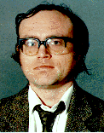
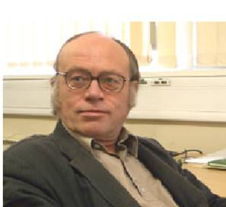
Overview
A review of my 40 years of engagement with argumentation: influences, lessons learned, and suggestions.

Slide 3
1972-78: Philosophy
Maths is about proof, but Philosophy is about argument
Proofs are constructed, understood, admired
Arguments are developed, engaged with, worried about
Proofs are audience independent, context free
Arguments have a time, a place and an audience
Epistemology: Argument from Illusion, Transcendental Argument, Private Language Argument
Philosophy of Religion: Ontological, Teleological, Cosmological Arguments

Slide 4
Argument From Illusion
Consider a Stick in a Jar of Water
What I see is bent
But the stick is straight
So I don’t see what is there
So I never experience the real world
So I can never know anything about the real world
The real world might not exist
I might be the only person in the universe
I might not even exist myself, just my perceptions
Not convincing, but what’s wrong with it?

Slide 5
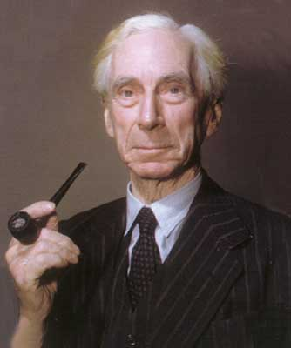
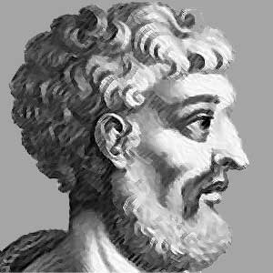
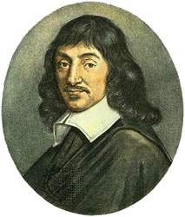
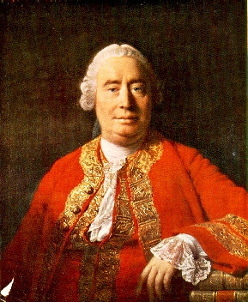
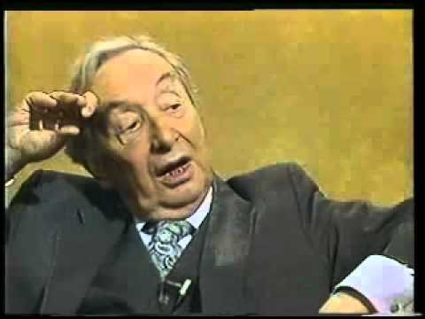
Arguments Don’t Go Away
Arguments don’t have a canonical form: each generation reinvents, re-expresses them, and falls under their spell again:
The Argument from Illusion Appears again and again: different illusions, but the same doubts

Slide 6
Two views of Philosophy
Bertrand Russell said:
The point of philosophy is to start with something so simple as not to seem worth stating, and to end with something so paradoxical that no one will believe it.
Wittgenstein said
The aim of philosophy is to show the fly the way out of the fly bottle
Arguments can amuse, or can entrap
philosophy
as game
philosophy
as obsession

Slide 7
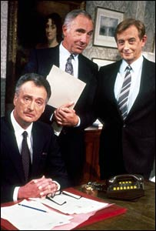
1978-84: Civil Service
Role of a UK Civil Servant (pre-Thatcher)
Given a policy question:
Find arguments for every option
Allow politicians to choose
Accept their choice
Justify their choice to parliament
Justify their choice to the public

Slide 8
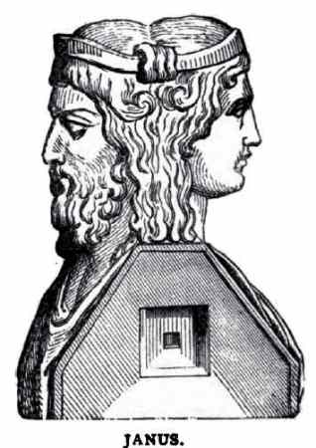
Lessons
There are no good arguments: there are arguments that people accept
Politicians will choose between arguments according to their aims, interests and aspirations
greater equality is a pro reason for some, and a con reason for others
The same policy needs different arguments for different people. We should cut taxes to:
Let people keep what they earn (employers)
To increase prosperity, in which all will share (workers)

Slide 9
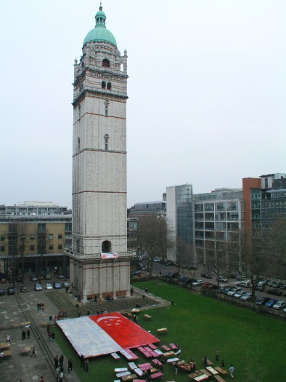
1984-87: Imperial College
Logic programming was developed by mathematicians
Program is a theory, a collection of axioms
Computation is deductive proof
Alternatively:
Program is a collection of beliefs, conjectures and prejudices (possibly incompatible)
Computation produces a set of arguments, perhaps both for and against, which can be taken or left

Slide 10
Closed World Assumption
Logic Programming interprets failure as negation
Completion of the Database makes it logically sound (if difficult to achieve except for definitions)
Argument from Ignorance makes it acceptable (subject to felicity conditions (critical questions))
Knowledge Based Systems are just
Argument from Expert Opinion?

Slide 11
Application to Law
The logic program can been seen as following standard legal procedure
Represent statutes, case law and (perhaps conflicting) opinion;
Generate arguments for both sides of a case and Choose between them
Bench-Capon and Sergot (1985). We need
“a representation in computer intelligible terms of what it is that makes an argument persuasive”
I’ve been more or less searching for this ever since

Slide 12
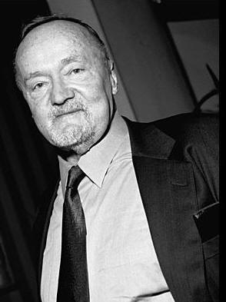
1987-2012: Liverpool - Explanation
If users are to choose between arguments they need them to be presented effectively
Enthymemes, assumptions, shared background, ignoring rare exceptions
Toulmin’s argumentation scheme gave a structure:
for navigation
basis for dialogue

Slide 13
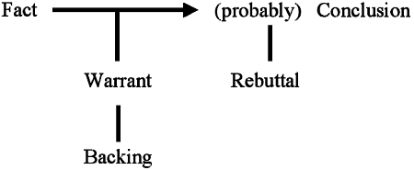
Toulmin’s Scheme
But does the rebuttal attack the qualifier,
the conclusion
the warrant or the backing?
Different kinds of attack:
compare critical questions of informal logic
and undercutters versus rebuttals in abstract argument

Slide 14
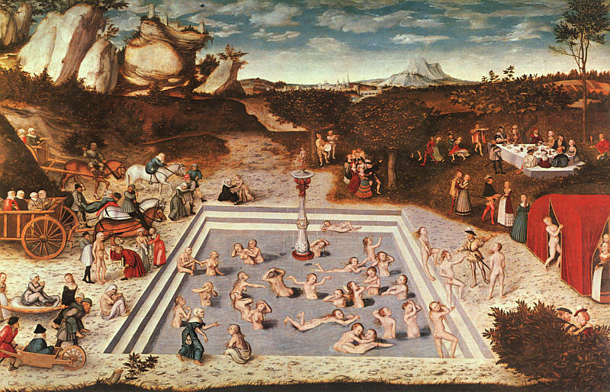
Roles for premises
John is old if
man(X)
age(X,A)
A > 75,
not has drunk the elixir of youth
In current systems, (e.g. Carneades)
common to distinguish
Assumptions: (John is a man)
Ordinary Premises: (John is aged over 75)
Exceptions: (John had drunk the elixir of youth)
Needs the sortal – usually presupposed
dogs get old more quickly
buildings get old more slowly
Not really an inequality
Trivial once A is bound
Really contains the knowledge
Men are (normally) old when they are 75
Not really a statement
Can’t be false
Just there to bind A
Exception
Not worth mentioning
Unless the question arises

Slide 15
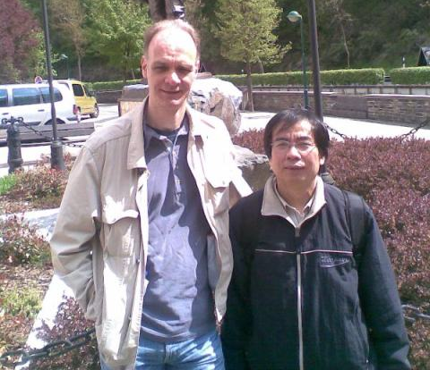
1995 – Dung - Context
Dung published his work on Argumentation Frameworks in 1993 (IJCAI) and 1995 (AIJ). The most significant idea for this community
Most important point (for me) is that
Arguments are evaluated in the context of other, related, arguments
Arguments cannot be considered in isolation. They are accepted relative to the context created by other arguments
Both attackers and defenders
Sets of arguments stand (or fall) together

Slide 16
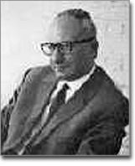
2000 onwards: Audiences
Preferred semantics can give us multiple preferred extensions – credulous (as well as sceptical) acceptance
But how do we choose between them? The choice is not arbitrary: think of politicians and judges
Perelman: The acceptability of the argument depends upon its audience

Slide 17
Attack and Defeat
Dung gave us credulous and sceptical acceptance
every attack succeeds, so there is no room for personal expression
In politics, in law, in morals, in life, we need to recognise that we are not compelled by arguments: we choose to accept them
An attack may fail: we need to distinguish attack from defeat
subjective and objective acceptance

Slide 18
Unsuccessful attack
Preferences:
Cayrol and Amgoud. A preference order on arguments. Framework has a single audience
Values:
Arguments are related to a (smallish) set of values. Audiences order the values (and hence the arguments). Framework has several audiences
Extended Argumentation:
Modgil. Arguments attack attacks as well as arguments. Preferences are arguments defeating certain attacks. Audiences are themselves arguments.
States preferences
Relates preferences
Explicit reasons for
(and against)preferences

Slide 19
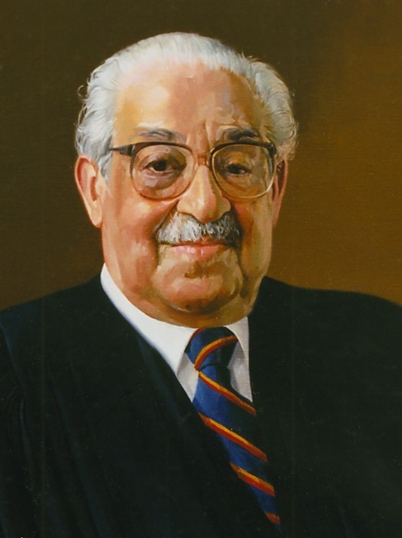
Relation to law
Laws are made for a purpose – to promote certain social values.
“Stare decisis must give way to changing values” – Thurgood Marshall (Supreme Court Justice)
Can explain variation between different times and different jurisdictions
Can provide the basis for reasoning about which argument to accept
Revenge is no longer an acceptable value
Marshall arguing against capital punishment:
Furman v Georgia (1972)
Revenge restored as a proper American value
Gregg v Georgia (1976)

Slide 20
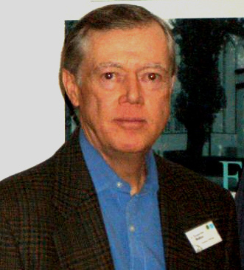
Argumentation Schemes
Logic programming showed us the need for argumentation schemes (expert opinion, ignorance)
Toulmin showed us the need to distinguish different roles for premises (assumptions, presumptions, exceptions)
Argumentation schemes provide a way of exploring these issues

Slide 21
Practical Reasoning
Scheme I have used most:
In the current circumstances
We should do this action
Which will have these consequences
And so realise this goal
Which will promote this value
Encapsulates
current beliefs, knowledge of possible plans, a causal theory, behavioural assumptions about others, theory of values, preferences, side effects etc.
A lot of reasoning hidden in this scheme

Slide 22
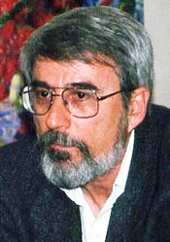
Models
Basis for many argumentation systems is a standard rule base
Argumentation schemes as defeasible rules
Same old problems of knowledge based systems since the 1980s:
lack robustness
hard to maintain
hard to reuse, extend and share knowledge
The answer to these problems was model based reasoning, reasoning from first principles, qualitative reasoning

Slide 23
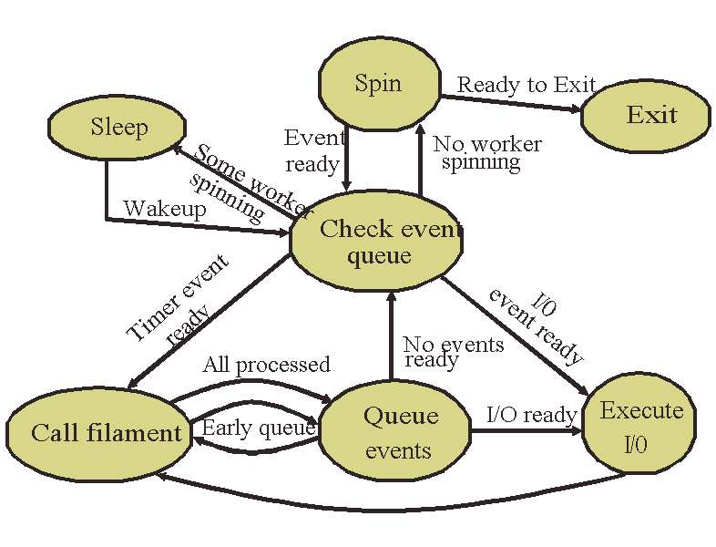
Models for Practical Reasoning
Alternating Action based Transition Systems make an effective basis for models to support practical reasoning
States can represent current beliefs and possible consequences
Transitions represent joint actions of the relevant agents
Label transitions with the values they promote and demote
See my demo later today

Slide 24
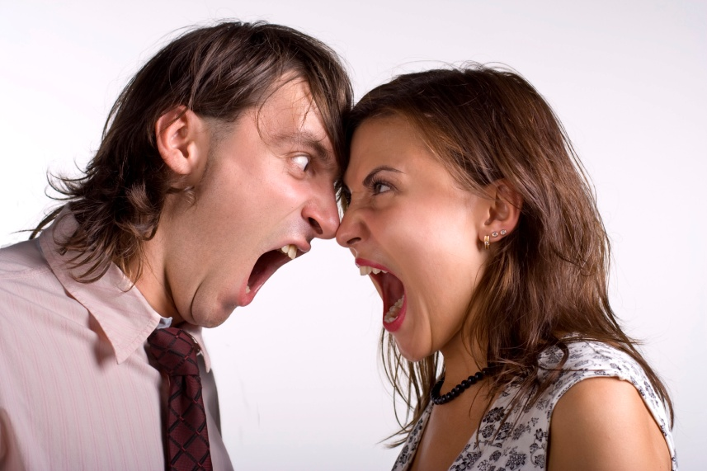
Modelling Real Arguments
It is all too easy to got lost in a formalism
Plenty of interest there, but it can be misleading
Some problems are artefacts of the representation
Often the answer is to represent the problem correctly, not to seek a technical fix
Make the problems concrete before looking for a solution
Flies back in the fly bottles
Real arguments can provide
a sanity check;
inspiration
more interest

Slide 25
Real Arguments Are Out There
Since 1984 I have worked in AI and Law
No shortage of arguments in the Legal Domain
Supreme Court Arguments
The wild animals cases
Fourth Amendment Cases
Capital Punishment cases
Lots of interest in argument mapping for understanding and analysis
Need to model them computationally too

Slide 26
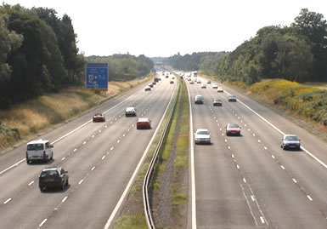
Why Argumentation?
Logic provides an idealisation of reasoning, a straight, well maintained highway
But most interesting problems (outside mathematics) do not fit this very well
Logic is a motorway, neat, tidy and effective
Argumentation is a country lane, slow and frustrating but interesting

Slide 27
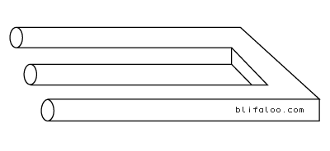
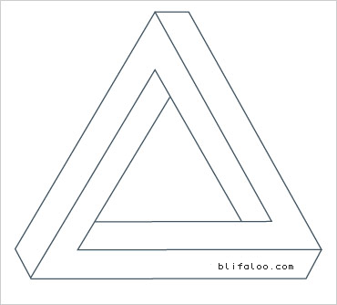
Interesting problems
One of more of the following features:
Have reasons for believing both sides
Are decided relative to a context
Are decided relative to the audience (and it is normal for different people to decide differently)
Conclusions are chosen not simply recognised
Are about values, aspirations and interests, not about facts
Is it true? Is often the least interesting question that can be asked. Is it interesting, helpful, beautiful are often much more important.

Slide 28
Computational Argumentation
Of course, computational argumentation, has its own mathematics. For abstract argumentation, we need formal methods and proofs
Plenty of that here
But don’t lose sight of why we do argumentation
Don’t lose all sight of real arguments, those made by real people in real situations
Don’t abstract all the interest away from them
Like people, it is the peculiarities and specific
features that make arguments worth studying

Slide 29
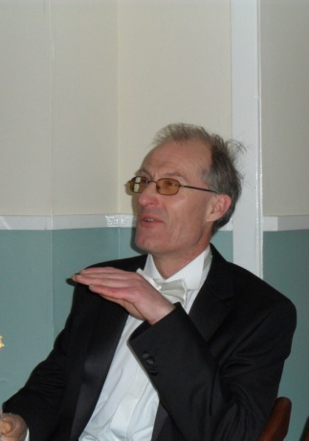
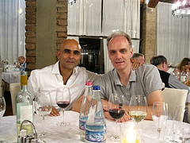
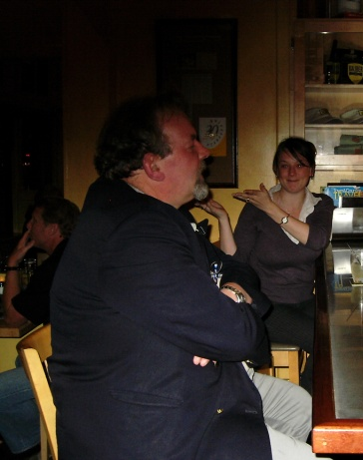
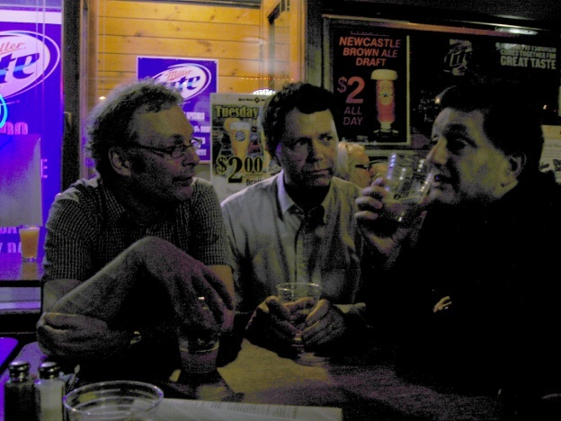
Thanks
To all former and current friends and colleagues, that I have argued with over the years

Slide 30
