Slide 1
Audiences and Argument Strength
Trevor Bench-Capon
University of Liverpool

Slide 2
Attack and Defeat
In Dung’s original abstract argumentation framework all attacks succeed and defeat the arguments they attack.
  No notion of different argument strengths
In extensions to Dung’s framework to accommodate preferences, attacks can fail
  Preference Based Argumentation (Cayrol and Amgoud (1996))
  Value Based Argumentation (Bench-Capon (2002))
A stronger argument can resist the attack of a weaker argument
  Other notions of strength are possible (e.g. extension based), but I shall use this one

Slide 3
Practical Reasoning
Preferences are essential for practical reasoning (reasoning about what should be done)
No objective answer, it depends on what the agent wants
Direction of Fit (Searle)
  In Theoretical Reasoning we try to fit our beliefs to the world
  In Practical Reasoning we try to fit the world to our desires
Agents differ in what they want, and so disagreement is rational
In this talk my focus is on practical reasoning

Slide 4
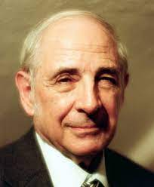
John Searle
Rationality in Action (2001)
Assume universally valid and accepted standards of rationality, assume perfectly rational agents operating with perfect information, and you will find that rational disagreement will still occur; because, for example, the rational agents are likely to have different and inconsistent values and interests, each of which may be rationally acceptable.

Slide 5

Chaim Perelman
The New Rhetoric (1969)
Perelman was a jurisprude: he characterised legal debate as:
“Each [party] refers in its argumentation to different values...the judge will allow himself to be guided, in his reasoning, by the spirit of the system i.e., by the values which the legislative authority seeks to protect and advance.”
Notion of an audience – the people to whom the argument is addressed

Slide 6
Characterising Audiences
In Preference Based Argumentation there is a single ranking
  No rationale for preferences
  Only one audience
In Value Based Reasoning, strengths are derived from the (social) values the arguments promote
  Values can be ordered differently by different audiences
  Audience is characterised by its value preferences
  Notions of
    Objective acceptance (accepted by all audiences) and
    Subjective acceptance (accepted by at least one audience)

Slide 7
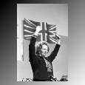

Taxation Debate
Raise taxes to
promote equality
Lower taxes to
promote enterprise
Which argument you will accept depends on the value you prefer
To be acceptable is to be acceptable to an audience
The audience determines argument strength

Slide 8
Uncertainties
There may be elements of uncertainty
  About the current situation
    The current state affects the outcome of actions
  About the effect of the action
    The effect of an action may not be determinate
  About what other agents might do
    Others may help us, or frustrate us
Can resolve uncertainties before choosing an action
Can weight values according to the agent’s preferences and calculate an expected utility for the actions.
  Gives a single ranking for an audience

Slide 9
Applications
Value Based reasoning has been applied to
  Law
  Medicine
  Behavioural Economics
  Moral reasoning
  General Problem Solving
  Other problems

Slide 10
Behavioural Economics
Classical economics assume all agents try to maximise wealth
  The “rational” consumer
But empirical studies show that this is not the case
  Prisoners Dilemma
    People do cooperate
  The Dictator Game
    People do give something to their partners
  The Ultimatum Game
    People reject small offers
Can account for this by using values other than wealth
Different behaviours of different social groups can be explained by prevailing value preferences of these groups

Slide 11
Value Based Reasoning
Value Based Reasoning
  Explains what is rational for an audience with a particular set of value preferences
But just as classical economics failed to predict behaviour, people may not do what is rational in this sense
There are other audience characteristics that need to be considered
What are these other characteristics?

Slide 12
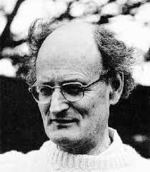
Authorities
Often people without reference to their values
The Moral Philosopher R.M.Hare argued that we sometimes think deeply about what to do, but usually we act on principles that we have formed in advance of any particular situation.
Trusted people:
  “My mother told me never to …”
  “My guru says”
Legal and moral precepts:
  “It is against the law”
  “I cannot break the ten commandments”
Specific advice:
  “My investment adviser tells me”
  “The guidebook says we should go there”

Slide 13
When do we Follow Authority?
It makes decisions easier and quicker
  Do we have the time to think things through?
  It the decision important enough?
If we do differ from authority we may
  Reject the authority
  Change our value ordering
  A choice must be made
Agents do not always make the same choice
  May sometimes follow authority and sometimes follow ones own values
  Depends on the context
Different agents will respect different authorities

Slide 14
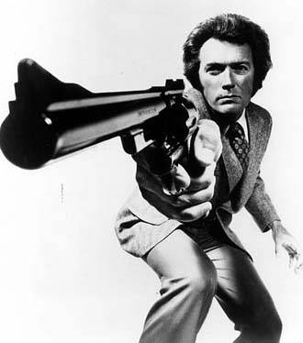

Risk
There are different attitudes to risk
Most people are (to some degree) risk adverse
Will not risk a substantial stake, even for a large expected return
  Don’t bet the farm on a full house
The greater the possible the loss, the less attractive the action – whatever the possible benefits
Different agents will differ as to their degree of risk aversion, some are naturally cautious and others are reckless
Attitudes to risk may change according to e.g. age or mood.
  “Tell, me. Do you feel Lucky?”

Slide 15
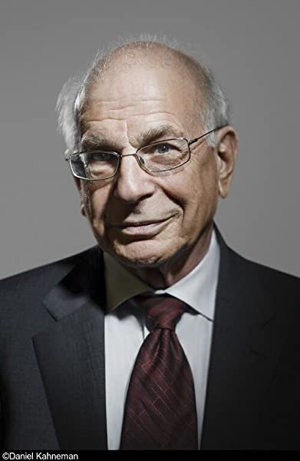
Loss Aversion
It also seems that people are loss averse
  Informally: A bird in the hand is worth two in the bush
  Rigorously: Kahneman, D. & Tversky, A. (1992). "Advances in prospect theory: Cumulative representation of uncertainty". Journal of Risk and Uncertainty
In behavioural economics
  You have $10: how much do you want to give your partner?
  Here is $10: how do you want to divide it between you and your partner?
  People are more generous in the latter case
Different people will be more or less loss averse
People will be more or less loss averse at different times

Slide 16
Explaining Behaviour
What a person chooses to do cannot be explained in terms of their values alone
  They may be following an authority
  They may regard the risk as too great
  They may be unwilling to sustain the loss for the expected gain
To fully describe an audience we need to be able to take all these things into account, not just values
  And perhaps others too
Different aspects will be prioritised in different contexts, so reducing to a single ranking is not fruitful

Slide 17
Influence on Dialogues
In persuasion,
persuavive arguments must respect not only the audience’s values, but also their authorities and degrees of risk and loss aversion
In deliberation
Consensus must be achieved not only on values, but on authorities to respect (or ignore), and acceptable degrees of risk and loss,
  and the priorities between these aspects

Slide 18
Computational Approaches
Could combine frameworks with different audience characteristics
For example, a framework with an audience determined by preferences over values with a framework with an audience determined by preferences over sources
  Has been tried in the legal domain, where assessment of witnesses and other evidence is crucial
Perhaps more flexible is the use of meta argumentation (Mogdil and Bench-Capon 2011))
Here we can rewrite a value based framework as an abstract argumentation framework with meta level arguments

Slide 19
Meta Level
A: Do X to promote V
B: Do Y to promote W
Values
Authority
Loss
X involves
loss
A is rejected
A defeats B
Our values
must be promoted
A is accepted
B is accepted
V > W
W > V
The loss is worth it
Y is illegal
B defeats A
B is rejected

Slide 20
Empirical Investigation
Need to look at real examples of the use of these aspects
Law is a fruitful source of such arguments
US Supreme Court
  Arguments for and against are presented in an Oral Hearing
  Justices write opinions explaining which arguments they accept and why:
    explicit discussion of which arguments are stronger for the justice
  Justices often disagree, so we get conflicting opinions
    Dissenting opinions – different outcome
    Concurring opinions – different reasons for the same outcome
  Furman v Georgia has opinions from all 9 justices

Slide 21


