Slide 1
A Dialogical Model of Case Law Dynamics
Trevor Bench-Capon and John Henderson
Dept of Computer Science, University of Liverpool, UK

Slide 2
Modelling the Development of Case Law
We are interested in how case law develops through a sequence of decisions
Like CATO and CABARET we use argument moves in a three ply argument dialogue
Proposal
Counter Argument
Rebuttal
However, we store the developing knowledge as a set of rules
As well as rules, factors can be modified by cases

Slide 3
Rules
Rules are always for a positive outcome
Negative outcome is the default, if no rules apply
Rules have three components:
Antecedent
If antecedent then positive outcome
Positive Exception
Even though the antecedent is not satisfied, there is a positive outcome
Negative Exception
Even though the antecedent is satisfied, there is a negative outcome
Positive exceptions differ from a new rule, because they are considered related to the rule rather than distinguished
Example – the rule covers school children and an exception is made to include people in further education. Including mentally incapable would be a new rule.

Slide 4
Factors
The antecedents, positive exceptions and negative exceptions are sets of factors
A factor is a legally significant pattern of facts
Standard usage, as begun with CATO
Factors are ascribed to a case of the basis of facts
As with the dimensions in HYPO
Cases can be described using several different factors
Factors may correspond to a range or several fact situations
Factors may be vague:
e.g. there may be several candidate upper bounds

Slide 5
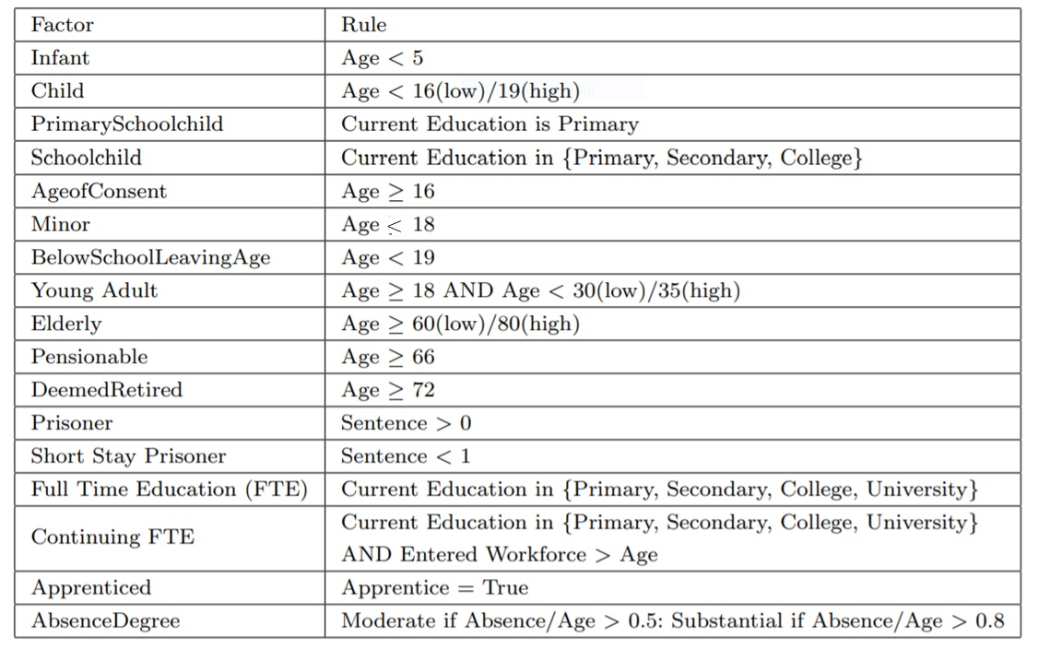
8 year old
Range
Vague
Several Facts
Boolean

Slide 6
Cases have Several Roles
To identify factors (say this fact pattern is relevant)
To clarify vague factors (choose an exact bound)
Note: cases are bundles of factors in CATO. We describe cases as bundles of facts (like HYPO). We want to argue about which factors apply.
To establish rules (this set of factors gives a positive outcome)
May introduce a new rule or confirm an old one
To establish positive exceptions (this set of factors gives a positive outcome)
To establish negative exceptions (this set of factors gives a negative outcome)
To establish value preferences
Many moves use a value which will be promoted to provide a rationale for accepting the argument
Values do not appear in rules, but are used to decide whether they are accepted

Slide 7
First Ply: Apply Existing Rules
ApplyRule(R). This can be played if there is a rule R for which the antecedent is satisfied by the new case. It argues for a positive outcome.
ApplyPosException(R,E,V). This can be played if there is a rule R with a positive exception E which is satisfied by the new case. V is the value promoted by the exception. It argues for a positive outcome.
ApplyNegException(R,N,V). This can be played if there is a rule R with a negative exception N which is satisfied by the new case. Again V is the value promoted by the exception. It argues for a negative outcome.
NoRule. This can be played if there is no rule for which the antecedent is satisfied by the new case. It argues for a negative outcome.

Slide 8
Second Ply: Counter Arguments to Using a Rule or Exception
DoesNotApply(R/PosEx/NegEx,Factor,NewFactor,V). Used when there is a vague factor. Proposes a new factor with a bound that would exclude the current case
ProposeException(R, Factor,V). Points to a factor that would justify an exeception to the proposed rule
Narrow(R/PosEx/NegEx, Factor, NewFactor, V). Prevents the rule from applying by narrowing the range of a factor
Broaden(NegEx,Factor,NewFactor,V). Enables a negative exception to apply by broadening the range of factor

Slide 9
Second Ply: Counter Arguments to NoRule
NewRule(R,V). Proposes a new rule to cover the current case. The factors in the antecedent are not related to an existing rule.
ProposeException(R,Factor,V). Proposes an exception to an existing rule, using related factors.
Broaden(R/PosEx, Factor,NewFactor). Enables a rule or positive exception to apply by broadening a facror to include the current case
Analogy(R,Factor1,Factor2,Similarities). This contends that, on the basis of some similarities, a factor in the current case is sufficiently analogous to an existing factor in the rule that they should be treated the same

Slide 10
Third Play: Rebuttal
RuleDoesApply(Factor,NewFactor2,V2). Rebuts RuleDoesNotApply by suggesting a factor to replace an existing factor and so bring the case under the rule.
NoPromotion(Factor,V) and Demotion(Factor,V2). Rebuts ProposeException, Narrow, Broaden and NewRule by saying that the value supposedly promoted is either not promoted or even demoted
Precedent(R/Exception,C). Rebuts DoesNotApply, NewRule and ProposeException by citing a precedent where the proposal applied but was not followed
TooGreat(Factor,NewFactor). Rebuts Broaden and Narrow, by suggesting there is too much difference
NoAnalogy(Factor1,Factor2,Differences). Rebuts Analogy by suggesting the differences outweigh the similarities.

Slide 11
Resolution
Following the arguments, the judge must decide whether to accept the rebuttal, or to accept the counter argument.
The different rebuttals may require different considerations, but in many cases the rationale for the proposal (the value) may be important.
Often the decision will require a modification to the existing rules:
Adding or changing (substituting, broadening, narrowing) a factor
Adding a new exception (positive or negative)
Adding a new rule

Slide 12
Example
Unfortunately the example had to be cut from the short version of the paper.
A fully worked example, following through a sequence of 18 cases, and exercising all the various moves is given in a technical report
Avaliable from
Department of Computer Science, Technical Reports
Link on my web page bibliography
https://cgi.csc.liv.ac.uk/research/techreports/tr2019/ulcs-19-003.pdf

