Slide 1
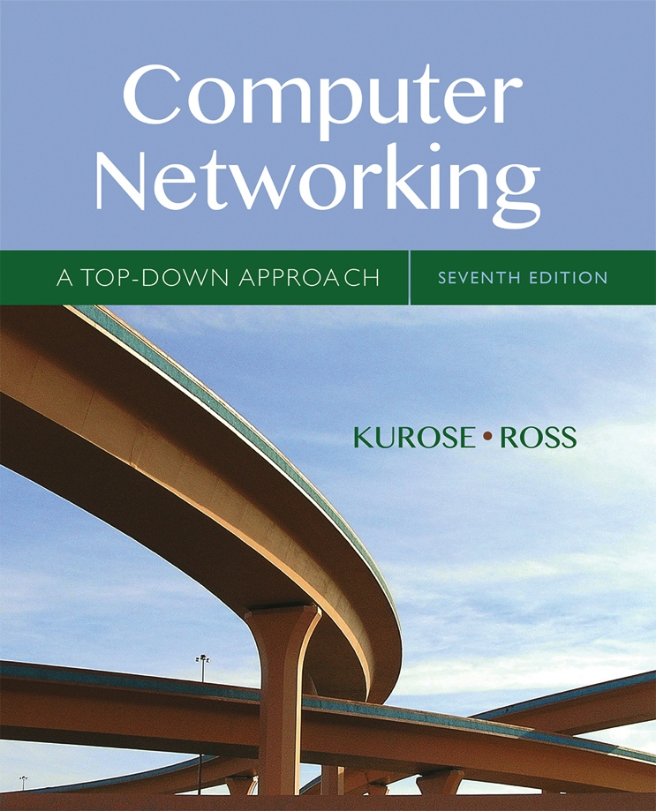

COMP211
Chapter 5
Network Layer:
The Control Plane
Computer Networking: A Top Down Approach
7th edition
Jim Kurose, Keith Ross
Pearson/Addison Wesley
April 2016
All material copyright 1996-2016
J.F Kurose and K.W. Ross, All Rights Reserved

Slide 2
Chapter 5: network layer control plane
chapter goals: understand principles behind network control plane
traditional routing algorithms
SDN controlllers
and their instantiation, implementation in the Internet:
OSPF, BGP, OpenFlow

Slide 3
Chapter 5: outline
5.1 introduction
5.2 routing protocols
link state
distance vector
5.3 intra-AS routing in the Internet: OSPF
5.4 routing among the ISPs: BGP
5.5 the SDN control plane

Slide 4
Network-layer functions
Recall: two network-layer functions:
forwarding: move packets from router’s input to appropriate router output
data plane
routing: determine route taken by packets from source to destination
control plane
Two approaches to structuring network control plane:
per-router control (traditional)
logically centralized control (software defined networking)

Slide 5

Per-router control plane
Individual routing algorithm components in each and every router interact with each other in control plane to compute forwarding tables
Routing
Algorithm
control
plane
data
plane

Slide 6
Logically centralized control plane
A distinct (typically remote) controller interacts with local control agents (CAs) in routers to compute forwarding tables
Remote Controller
control
plane
data
plane
CA
CA
CA
CA
CA

Slide 7
Chapter 5: outline
5.1 introduction
5.2 routing protocols
link state
distance vector
5.3 intra-AS routing in the Internet: OSPF
5.4 routing among the ISPs: BGP
5.5 The SDN control plane

Slide 8
Routing
Routing protocol
Goal: determine “good” path
(sequence of routers) through
network from source to destination.
5
B
3
C
2
5
A
2
1
F
3
1
2
Graph abstraction for routing algorithms:
graph nodes are routers
graph edges are physical links
  link cost: delay, $ cost, or congestion level
D
E
1
“good” path:
  typically means minimum cost path
  other def’s possible

Slide 9
Routing algorithm classification
Q: global or decentralized information?
global:
all routers have complete topology, link cost info
“link state” algorithms
decentralized:
router knows physically-connected neighbors, link costs to neighbors
iterative process of computation, exchange of info with neighbors
“distance vector” algorithms
Q: static or dynamic?
static:
routes change slowly over time
dynamic:
routes change more quickly
  periodic update
  in response to link cost changes

Slide 10
Chapter 5: outline
5.1 introduction
5.2 routing protocols
link state
distance vector
5.3 intra-AS routing in the Internet: OSPF
5.4 routing among the ISPs: BGP
5.5 The SDN control plane

Slide 11
Making routing scalable
our routing study thus far - idealized
all routers identical
network “flat”
… not true in practice
scale: with billions of destinations:
can’t store all destinations in routing tables!
routing table exchange would swamp links!
administrative autonomy
internet = network of networks
each network admin may want to control routing in its own network

Slide 12
Internet approach to scalable routing
aggregate routers into regions known as “autonomous systems” (AS) (a.k.a. “domains”)
intra-AS routing
routing among hosts, routers in same AS (“network”)
all routers in AS must run same intra-domain protocol
routers in different AS can run different intra-domain routing protocol
gateway router: at “edge” of its own AS, has link(s) to router(s) in other AS’es
inter-AS routing
routing among AS’es
gateways perform inter-domain routing (as well as intra-domain routing)

Slide 13
Interconnected ASes
3c
3a
2c
3b
AS3
2a
1c
2b
AS2
1a
1b
1d
AS1
forwarding table configured by both intra- and inter-AS routing algorithm
  intra-AS routing determine entries for destinations within AS
  inter-AS & intra-AS determine entries for external destinations
Intra-AS
Routing
algorithm
Inter-AS
Routing
algorithm
Forwarding
table

Slide 14
Intra-AS Routing
also known as interior gateway protocols (IGP)
most common intra-AS routing protocols:
  RIP: Routing Information Protocol
  OSPF: Open Shortest Path First (IS-IS protocol essentially same as OSPF)
  IGRP: Interior Gateway Routing Protocol (Cisco proprietary for decades, until 2016)

Slide 15
OSPF (Open Shortest Path First)
“open”: publicly available
uses link-state algorithm
  link state packet dissemination
  topology map at each node
  route computation using Dijkstra’s algorithm
router floods OSPF link-state advertisements to all other routers in entire AS
  carried in OSPF messages directly over IP (rather than TCP or UDP
  link state: for each attached link
hierarchical OSPF in large domains (see next slide)
IS-IS routing protocol: nearly identical to OSPF

Slide 16
Hierarchical OSPF
boundary router
backbone router
backbone
area
border
routers
area 3
two-level hierarchy:
local area, backbone.
  link-state
  advertisements only in area
  each nodes has detailed area topology; only know direction (shortest path) to nets in other areas.
area border routers: “summarize” distances to nets in own area, advertise to other Area Border routers.
backbone routers: run OSPF routing limited to backbone.
boundary routers: connect to other AS‘s.
internal
routers
area 1
area 2

Slide 17
Chapter 5: outline
5.1 introduction
5.2 routing protocols
link state
distance vector
5.3 intra-AS routing in the Internet: OSPF
5.4 routing among the ISPs: BGP
5.5 The SDN control plane
5.6 ICMP: The Internet Control Message Protocol
5.7 Network management and SNMP

Slide 18
Internet inter-AS routing: BGP
BGP (Border Gateway Protocol): the de facto inter-domain routing protocol
  “glue that holds the Internet together”
BGP provides each AS a means to:
  eBGP: obtain subnet reachability information from neighboring ASes
  iBGP: propagate reachability information to all AS-internal routers.
  determine “good” routes to other networks based on reachability information and policy
allows subnet to advertise its existence to rest of Internet: “I am here”

Slide 19
BGP basics
BGP session: two BGP routers (“peers”) exchange BGP messages over semi-permanent TCP connection:
  advertising paths to different destination network prefixes (BGP is a “path vector” protocol)
when AS3 gateway router 3a advertises path AS3,X to AS2 gateway router 2c:
  AS3 promises to AS2 it will forward datagrams towards X
AS 3
3b
AS 1
1b
3a
3c
1a
1c
AS 2
2b
3d
X
1d
2a
2c
BGP advertisement:
AS3, X
2d

Slide 20
Path attributes and BGP routes
advertised prefix includes BGP attributes
  prefix + attributes = “route”
two important attributes:
  AS-PATH: list of ASes through which prefix advertisement has passed
  NEXT-HOP: indicates specific internal-AS router to next-hop AS
Policy-based routing:
  gateway receiving route advertisement uses import policy to accept/decline path (e.g., never route through AS Y).
  AS policy also determines whether to advertise path to other other neighboring ASes

Slide 21
BGP path advertisement
AS3
3b
AS1
1b
3a
3c
1a
1c
AS2
2b
3d
X
1d
AS3,X
AS2,AS3,X
2a
2c
2d
AS2 router 2c receives path advertisement AS3,X (via eBGP) from AS3 router 3a
Based on AS2 policy, AS2 router 2c accepts path AS3,X, propagates (via iBGP) to all AS2 routers
Based on AS2 policy, AS2 router 2a advertises (via eBGP) path AS2, AS3, X to AS1 router 1c

Slide 22
BGP path advertisement
AS3
3b
AS1
1b
AS3,X
3a
3c
1a
1c
AS2
2b
3d
X
1d
AS3,X
AS2,AS3,X
2a
2c
2d
gateway router may learn about multiple paths to destination:
AS1 gateway router 1c learns path AS2,AS3,X from 2a
AS1 gateway router 1c learns path AS3,X from 3a
Based on policy, AS1 gateway router 1c chooses path AS3,X, and advertises path within AS1 via iBGP

Slide 23
BGP, OSPF, forwarding table entries
Q: how does router set forwarding table entry to distant prefix?
AS3
3b
AS1
1b
AS3,X
1
AS3,X
3a
3c
1a
2
1c
local link interfaces
at 1a, 1d
AS2
2b
3d
X
2
1d
1
AS3,X
AS2,AS3,X
2a
2c
physical link
2d
dest
interface
recall: 1a, 1b, 1c learn about dest X via iBGP from 1c: “path to X goes through 1c”
…
…
…
…
X
1
1d: OSPF intra-domain routing: to get to 1c, forward over outgoing local interface 1

Slide 24
BGP, OSPF, forwarding table entries
Q: how does router set forwarding table entry to distant prefix?
AS3
3b
AS1
1b
1
3a
3c
1a
2
1c
AS2
2b
3d
X
1d
2a
2c
2d
dest
interface
recall: 1a, 1b, 1c learn about dest X via iBGP from 1c: “path to X goes through 1c”
…
…
…
…
X
2
1d: OSPF intra-domain routing: to get to 1c, forward over outgoing local interface 1
1a: OSPF intra-domain routing: to get to 1c, forward over outgoing local interface 2

Slide 25
BGP route selection
Router may learn about more than one route to destination AS. Router must select route.
  RouteViews Project: http://www.routeviews.org
    telnet route-views.linx.routeviews.org
    show ip bgp 171.67.0.0/14 longer-prefixes
Route selection rules:
  local preference value attribute: policy decision
  shortest AS-PATH
  closest NEXT-HOP router: hot potato routing
  additional criteria

Slide 26
Why different Intra-, Inter-AS routing ?
policy:
inter-AS: admin wants control over how its traffic routed, who routes through its net.
intra-AS: single admin, so no policy decisions needed
scale:
hierarchical routing saves table size, reduced update traffic
performance:
intra-AS: can focus on performance
inter-AS: policy may dominate over performance

Slide 27
Chapter 5: outline
5.1 introduction
5.2 routing protocols
link state
distance vector
5.3 intra-AS routing in the Internet: OSPF
5.4 routing among the ISPs: BGP
5.5 The SDN control plane

Slide 28
Software defined networking (SDN)
Internet network layer: historically has been implemented via distributed, per-router approach
  monolithic router contains switching hardware, runs proprietary implementation of Internet standard protocols (IP, RIP, IS-IS, OSPF, BGP) in proprietary router OS (e.g., Cisco IOS)
  different “middleboxes” for different network layer functions: firewalls, load balancers, NAT boxes, ..
~2005: renewed interest in rethinking network control plane

Slide 29
Recall: per-router control plane
Individual routing algorithm components in each and every router interact with each other in control plane to compute forwarding tables
Routing
Algorithm
control
plane
data
plane

Slide 30
Recall: logically centralized control plane
A distinct (typically remote) controller interacts with local control agents (CAs) in routers to compute forwarding tables
Remote Controller
control
plane
data
plane
CA
CA
CA
CA
CA

Slide 31
Software defined networking (SDN)
Why a logically centralized control plane?
easier network management: avoid router misconfigurations, greater flexibility of traffic flows
table-based forwarding (recall OpenFlow API) allows “programming” routers
  centralized “programming” easier: compute tables centrally and distribute
  distributed “programming: more difficult: compute tables as result of distributed algorithm (protocol) implemented in each and every router
open (non-proprietary) implementation of control plane

Slide 32
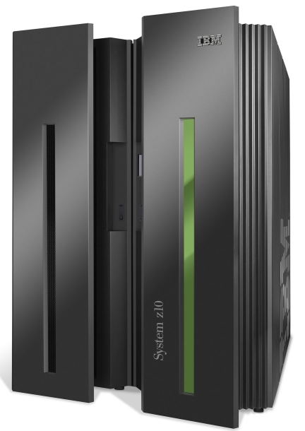
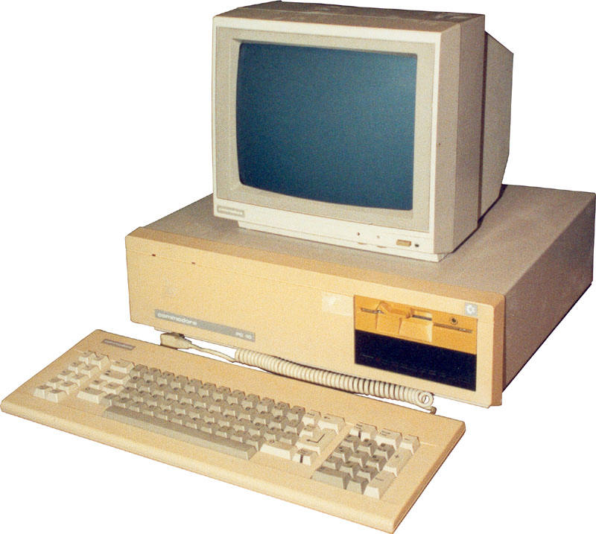
Analogy: mainframe to PC evolution*
App
App
App
App
App
App
App
App
App
App
App
Specialized
Applications
Open Interface
Specialized
Operating
System
Windows
(OS)
Linux
Mac
OS
or
or
Specialized
Hardware
Open Interface
Microprocessor
Vertically integrated
Closed, proprietary
Slow innovation
Small industry
Horizontal
Open interfaces
Rapid innovation
Huge industry
* Slide courtesy: N. McKeown

Slide 33

Traffic engineering: difficult traditional routing
5
3
v
w
5
2
u
2
1
z
3
1
2
x
y
1
Q: what if network operator wants u-to-z traffic to flow along uvwz, x-to-z traffic to flow xwyz?
A: need to define link weights so traffic routing algorithm computes routes accordingly (or need a new routing algorithm)!
Link weights are only control “knobs”: wrong!
Notes:
Note: implicit assumption here: destination based forwarding

Slide 34
Traffic engineering: difficult
5
3
v
w
5
2
u
2
1
z
3
1
2
x
y
1
Q: what if network operator wants to split u-to-z traffic along uvwz and uxyz (load balancing)?
A: can’t do it (or need a new routing algorithm)
Notes:
Note: implicit assumption here: destination based forwarding

Slide 35
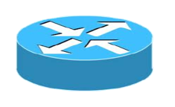
Traffic engineering: difficult
Networking 401
5
v
3
w
2
v
w
5
u
2
1
z
3
z
1
2
x
y
x
1
y
Q: what if w wants to route blue and red traffic differently?
A: can’t do it (with destination based forwarding, and LS, DV routing)
Notes:
Note: implicit assumption here: destination based forwarding

Slide 36
Software defined networking (SDN)
4. programmable control applications
…
3. control plane functions external to data-plane switches
routing
access control
load
balance
Remote Controller
control
plane
data
plane
CA
2. control, data plane separation
CA
CA
CA
CA
1: generalized“ flow-based” forwarding (e.g., OpenFlow)

Slide 37
SDN perspective: data plane switches
Data plane switches
fast, simple, commodity switches implementing generalized data-plane forwarding (Section 4.4) in hardware
switch flow table computed, installed by controller
API for table-based switch control (e.g., OpenFlow)
  defines what is controllable and what is not
protocol for communicating with controller (e.g., OpenFlow)
network-control applications
…
routing
access
control
load
balance
control
plane
northbound API
SDN Controller
(network operating system)
southbound API
data
plane
SDN-controlled switches

Slide 38
SDN perspective: SDN controller
SDN controller (network OS):
maintain network state information
interacts with network control applications “above” via northbound API
interacts with network switches “below” via southbound API
implemented as distributed system for performance, scalability, fault-tolerance, robustness
network-control applications
…
routing
access
control
load
balance
control
plane
northbound API
SDN Controller
(network operating system)
southbound API
data
plane
SDN-controlled switches

Slide 39
SDN perspective: control applications
network-control apps:
“brains” of control: implement control functions using lower-level services, API provided by SND controller
unbundled: can be provided by 3rd party: distinct from routing vendor, or SDN controller
network-control applications
…
routing
access
control
load
balance
control
plane
northbound API
SDN Controller
(network operating system)
southbound API
data
plane
SDN-controlled switches

Slide 40
Components of SDN controller
routing
access
control
load
balance
Interface layer to network control apps: abstractions API
Interface, abstractions for network control apps
…
network graph
RESTful
API
intent
Network-wide state management layer: state of networks links, switches, services: a distributed database
…
statistics
flow tables
SDN
controller
Network-wide distributed, robust state management
…
Link-state info
host info
switch info
…
communication layer: communicate between SDN controller and controlled switches
OpenFlow
SNMP
Communication to/from controlled devices

Slide 41

OpenFlow protocol
operates between controller, switch
TCP used to exchange messages
  optional encryption
three classes of OpenFlow messages:
  controller-to-switch
  asynchronous (switch to controller)
  symmetric (misc)
OpenFlow Controller

Slide 42
SDN: control/data plane interaction example
Dijkstra’s link-state
Routing
1
S1, experiencing link failure using OpenFlow port status message to notify controller
4
5
…
network graph
RESTful
API
intent
2
SDN controller receives OpenFlow message, updates link status info
3
…
statistics
flow tables
…
3
Dijkstra’s routing algorithm application has previously registered to be called when ever link status changes. It is called.
Link-state info
host info
switch info
2
…
OpenFlow
SNMP
6
4
Dijkstra’s routing algorithm access network graph info, link state info in controller, computes new routes
1
s2
s1
s4
s3

Slide 43
SDN: control/data plane interaction example
Dijkstra’s link-state
Routing
4
5
…
network graph
RESTful
API
intent
5
link state routing app interacts with flow-table-computation component in SDN controller, which computes new flow tables needed
3
…
statistics
flow tables
…
Link-state info
host info
switch info
2
…
6
Controller uses OpenFlow to install new tables in switches that need updating
OpenFlow
SNMP
6
1
s2
s1
s4
s3

Slide 44
Chapter 5: summary
we’ve learned a lot!
approaches to network control plane
  per-router control (traditional)
  logically centralized control (software defined networking)
traditional routing algorithms
  implementation in Internet: OSPF, BGP
SDN controllers
next stop: link layer!

